Slide 1
Research Update
Edward Liu 01/05/2026

Slide 2
Chapter 1
Looking at the fitness effect of E. coli with rpoB mutations from our lab
Growing them across a wide temperature spectrum ideally from 22°C-42°C
Also across two types of media LB and M9
Notes:
LB is rich and M9 is minimal
review I will define fitness effect as the effect a mutation has on an organism’s ability to survive in a given environment. So in this case I will be using max od and muamx as a measurement of fitness
This definition is broad and inclusive but most importantly does not propose an assumption of whether it is good or bad. Conversely, cost of resistance is defined as the price an organism pays to survive that is usually in the reduction of fitness in an environment due to factors like antibiotics, pesticides, and toxins. With the definitions I have listed above in mind the main issue we have with the term cost of resistance is that it is too narrow and that it is too much of an assumption often made too early. This is because if we have already labled an effect as a “cost” we are already assuming it is inherently negative when in reality this “cost” that we think we see in our specific treated environment could be neutral or even beneficial in another environment.

Slide 3
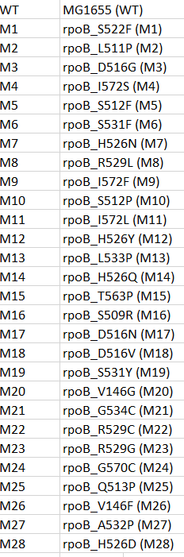
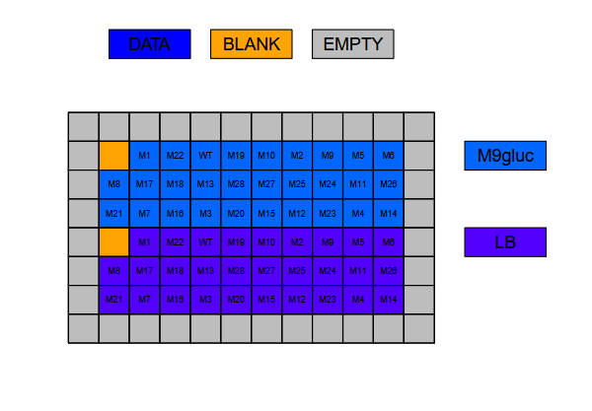
Design
Picked 28 mutants and the WT to test
Notes:
Explain mutation list
So how we set up the epxeiremnt was that we test mutants under 1 temperature in 2 media. How we do this is we split a 96 well plate in 2 and After we exclude the border there are 60 wells left then if we blank 2 one ofr m9 one for lb it will give us 58 wells which nicely leaves us with 29 wells per growth media which fits nicely with my 28 mutants and WT. This way we can test the effect of temperature on our mutant across the two different media.

Slide 4
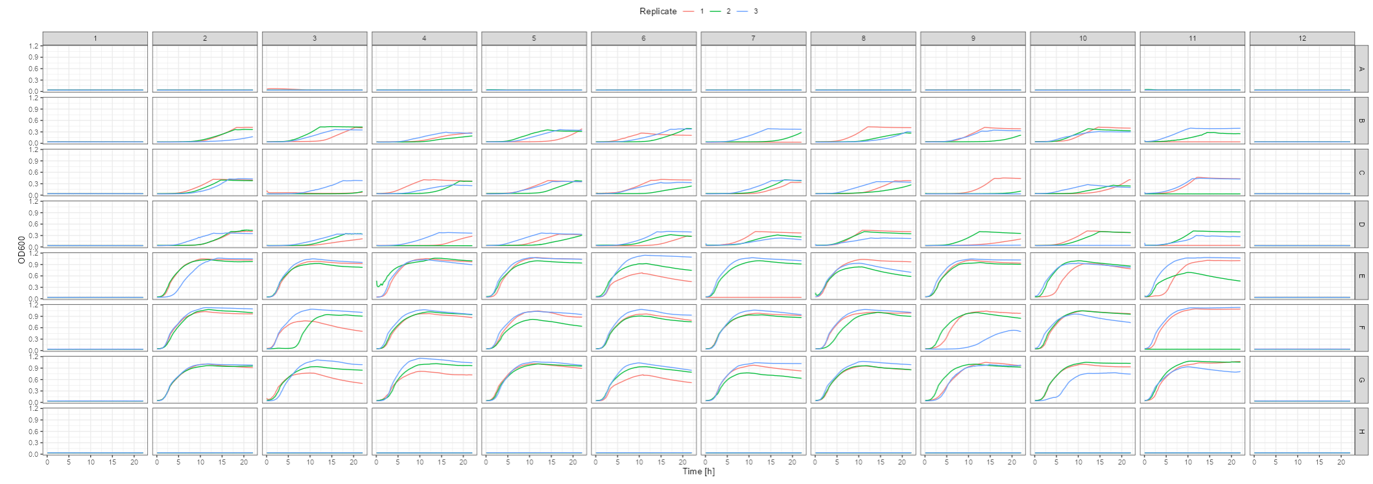
Initial findings
I first tested the temperature ranges that would constitute heat stress heat stress for E. coli (42°c)
Notes:
Explain how the spec fits with shiny plate
Keep in mind the top half is m9 and the bottom half is LB. As expected LB grew much better than m9 however they grew too well at 42c for this temperature to be considered stressful
Andrew mention you can see the sharp stop once while in LB its much more smooth slope

Slide 5
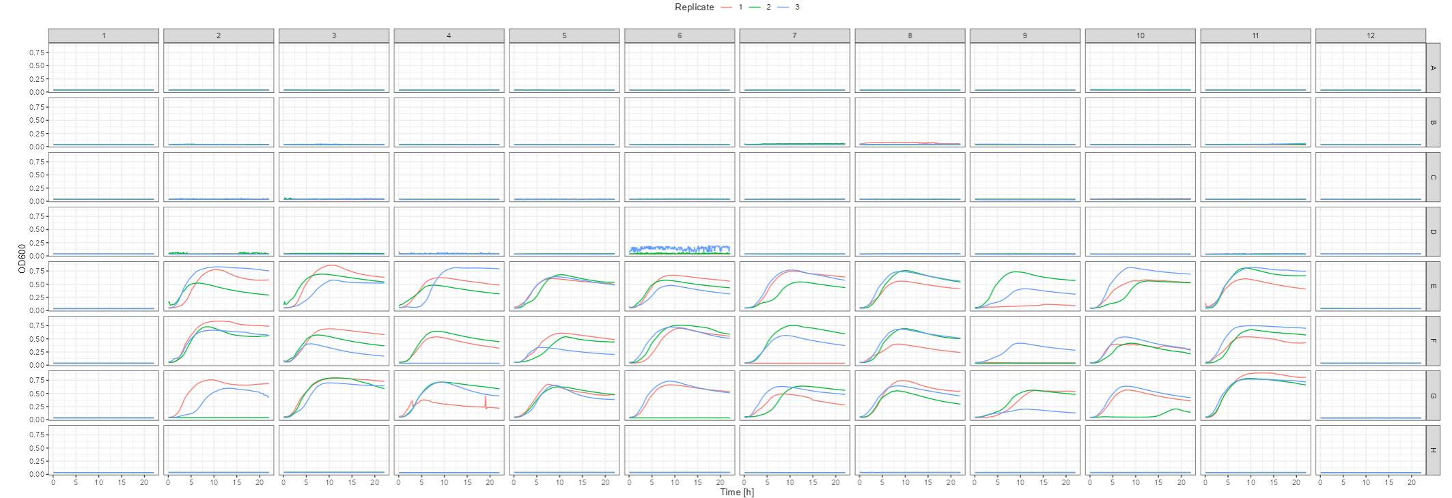
45°c
Notes:
I upped the temp to 45 and from what we can see the bacteria in m9 has completely stopped growing however LB still looks too good

Slide 6
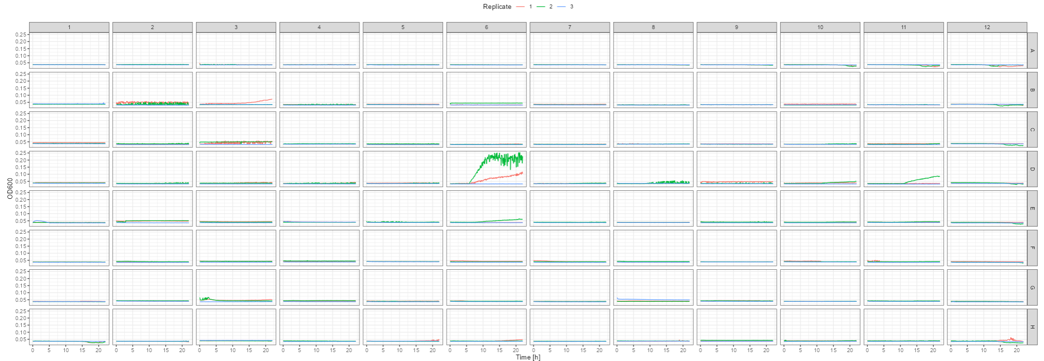
48°c
Notes:
Finally I changed the temp to 48 and we finally see no growth.

Slide 7
22°c
I then tested the lower end of my temperature spectrum
But we found the temperature in the lab is between 26°c - 28°c
Notes:
I might attempt this in winter

Slide 8
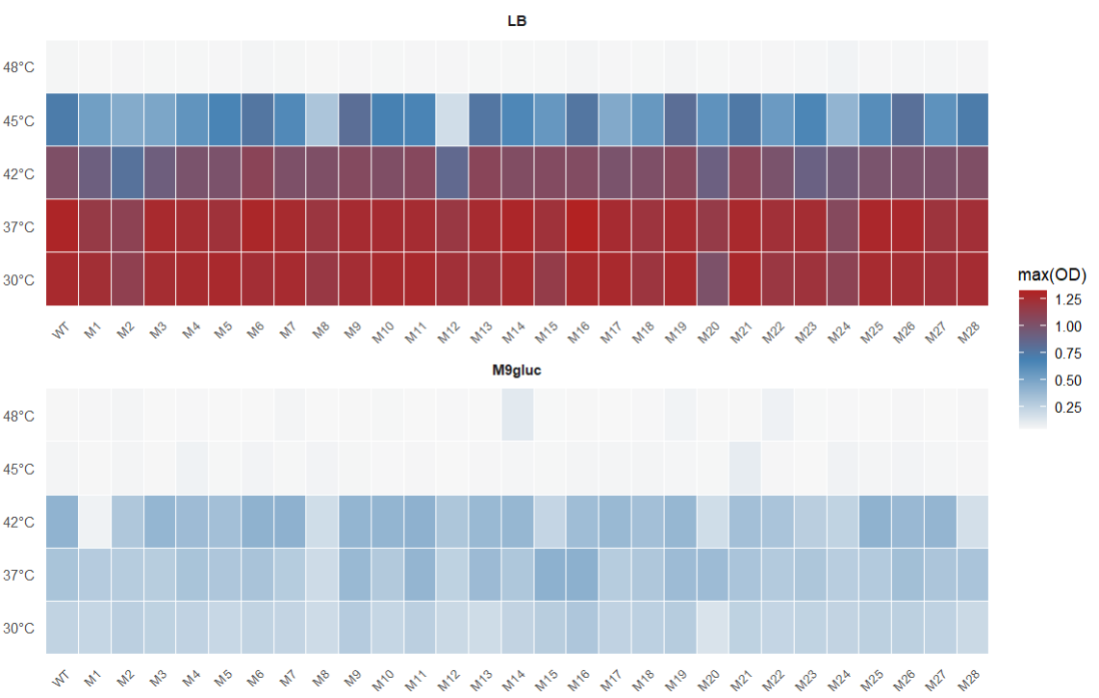
MAXOD Heatmap
Notes:
Tempeartrue one the side mutants at the bottom. They start from groing really well to not at all They reach saturation at 30-37 in LB and 42-37-30 in M9

Slide 9
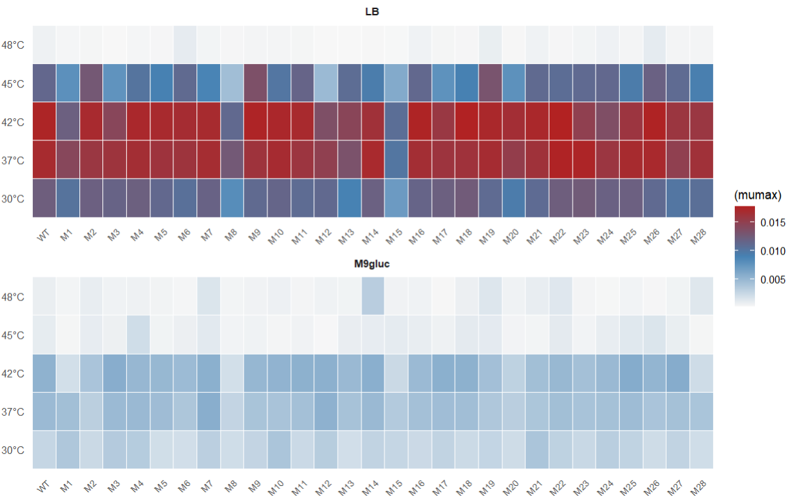
MUMAX Heatmap
Notes:
Sweet spot for growth is between 37 and 42 in lb and m9

Slide 10
Initial Observations
At 48 °c nothing survives while mutants in M9 stop growing at 45 °c
Our mutations and WT seem to be heat resistant
It seems like rich media helps with growth at high temperature
Notes:
OD is highest for most mutants grown in M9 at 42c which is not traditionally optimal. Even though the mutants are growing better in LB than M9 at high temp its interesting that the optimal for LB seems to be at 30-37c while m9 it seems to be 42 and maybe 37. the high mumax for LB at 42 is not translating to OD (even though our mutants can grow at 45 in LB it is seems to prefer 30-37 while although mutants don’t grow in M9 at 45 it seems to prefer 42c)
At 42 LB has a high mumax but low OD which might be stress response as when under stress some bacteria can grow fast but ultimately cannot sustain it, resulting in low final yield. Meanhile although the mumax is low at 30c the OD is high
our results show that our mutations mostly grow the same as WT
rpoB does not provide benefit because WT grew just as well without it??
Other side is that we expect that rpoB mutations will be deleterious at a stressful temperature without RIF, but it seems to be fine
So while it does not provide extra benefit it seems to not be a burden on the bacteria

Slide 11
Chapter 2
Looking at why there is an uneven distribution of mutation rate in our RIF mutants

Slide 12
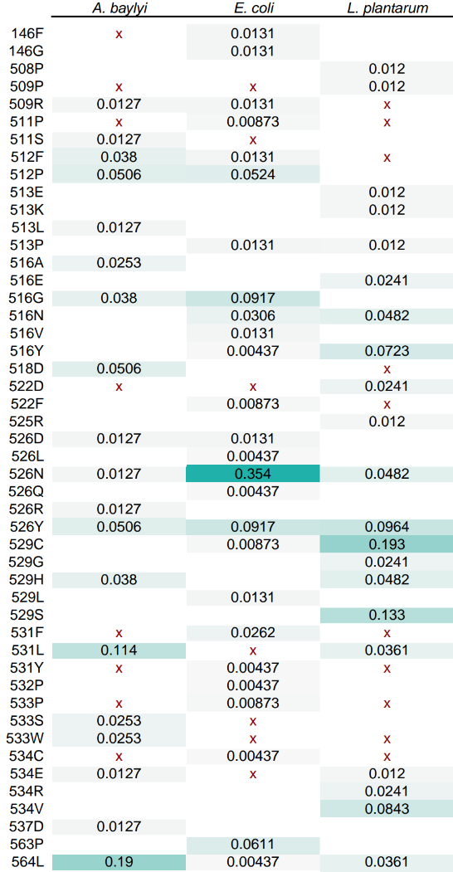
Background
There seems to be an uneven distribution of mutations. Results from the E. coli, A. baylyi and L. plantarum screens show that some mutations are much more favoured than others or we simply see more of them
Mutants that appear from mutant screens are stochastic
I want to test to see if establishment is also stochastic or if there are certain factors during this phase that is causing the distribution that we see
Notes:
Explain the table
The mutation rate is unevenly distributed why?
The hypothesis is that the mutations we see less of are not “good” mutants and the cost is causing them to die

Slide 13
Design
Pick a rare mutant
Pick an abundant mutant
Pick a mutant somewhere in the middle
Pick the WT
Grow over many repetitions on LB and RIF plates to see if there is a difference in the number of colonies that appear
Notes:
To test if this is true …
Testing to see if there is correlation between mutation rate and survivability
i

Slide 14
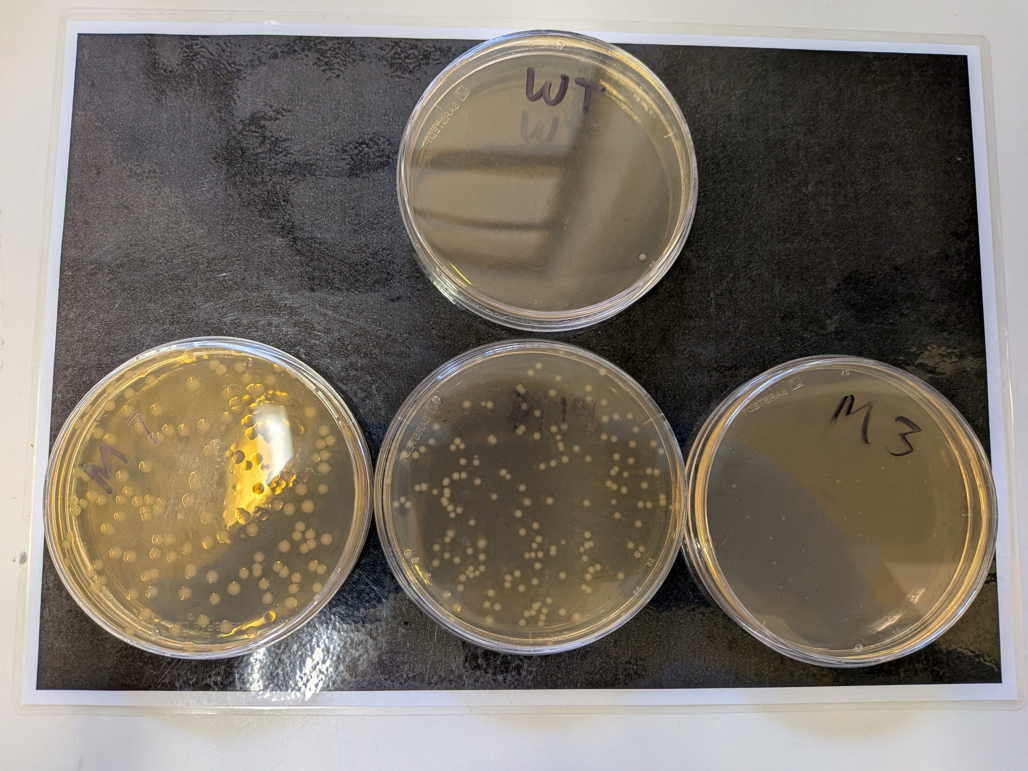
Initial Experiment
Notes:
Ideally we see the mutants with the highest mutation rate to have the most number of colonies and the rare mutants to have much or less as they are all dead (hopefully this supports the idea that the reason we see so many of the same mutation pop up is because it managed to live longer than the rare mutations

Slide 15
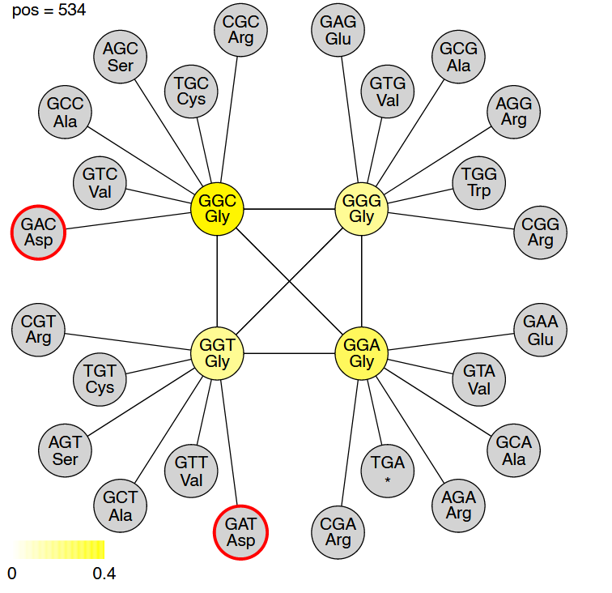
What literature suggests
Stochasticity
Inoculum size
High mutational accessibility
Compensatory mutations
Notes:
Negin’s Only the GGC and the GGT codons can mutate toward codons coding for aspartic acid (A) in a single step so it will be the most likely
TCG→TTG is a single-step mutation unique to MTB
S531L gives high MIC but impairs growth less than 526/516
S531L uniquely recruits rpoA/C compensatory mutations
Compensated S531L strains spread clonally

Slide 16
1. Bolourchi, N., Brown, C. R. P., Letten, A. D., & Engelstädter, J. (2024). Evolution and evolvability of rifampicin resistance across the bacterial tree of life. Evolutionary Biology. https://doi.org/10.1101/2024.11.05.622190

Slide 17
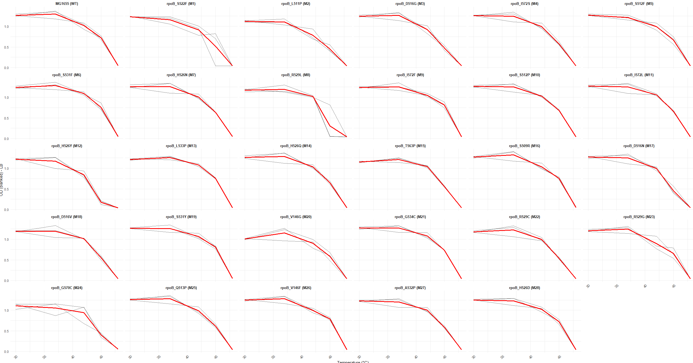
OD LB
Notes:
Red line is the average

Slide 18
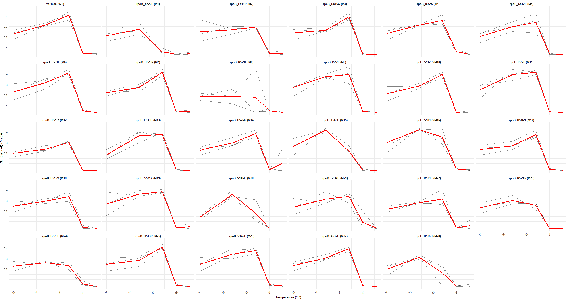
OD M9

Slide 19
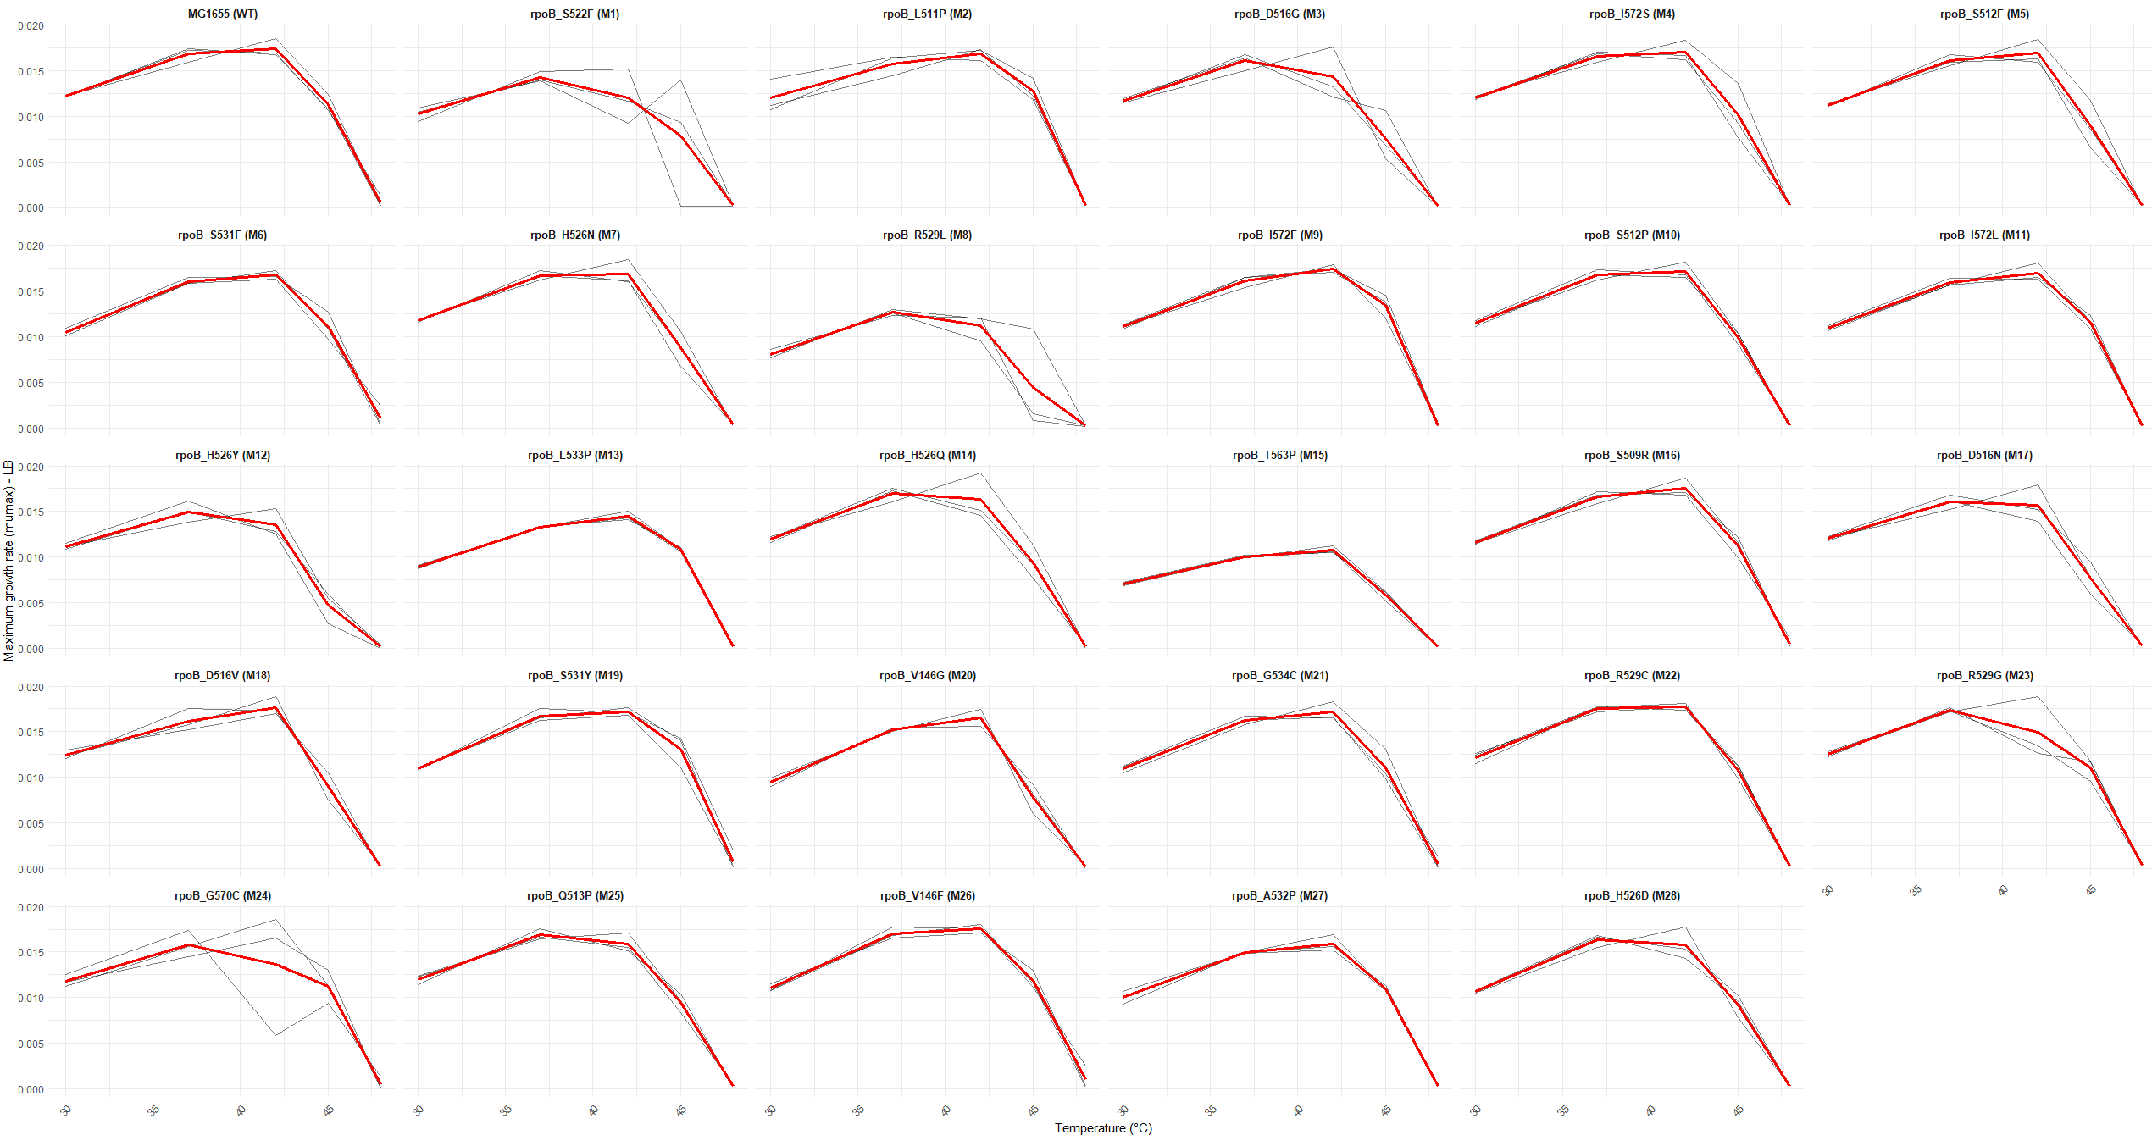
MUMAX LB

Slide 20
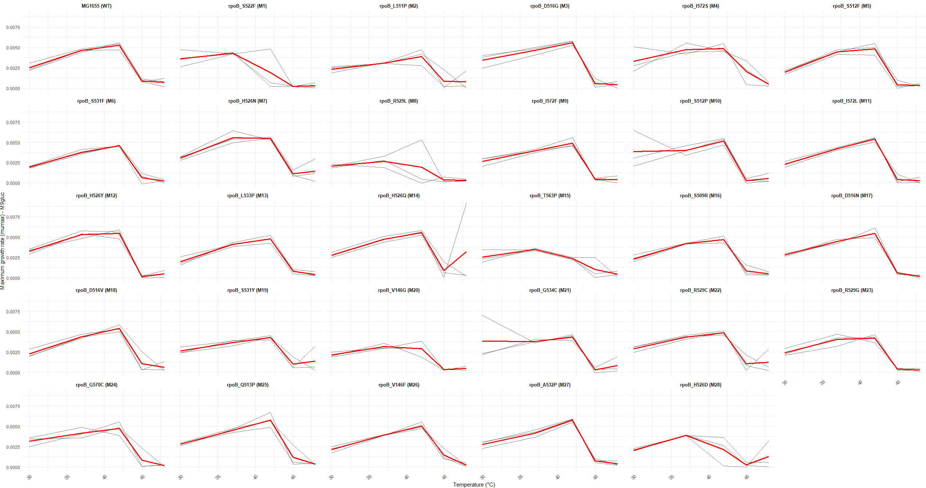
MUMAX M9

